Slide 1
KKR & KSR INSTITUTE OF TECHNOLOGY & SCIENCES ​ (Autonomous)​ Vinjanampadu , Guntur(District)​ Department of Computer Science and Engineering Amniotic Fluid and Fetus Growth detection Using Deep Learning ​ ​
Under the Supervision of
Mr.B. Satya Narayana Reddy Associate Professor
Ch. Venkata Sai(21JR1A0544) G.Sriharsha (21JR1A0554)​ G.Krishna Teja (21JR1A0550)​ D.VishnuVardhan(21JR1A0545)

Slide 2
INDEX
Abstract
Introduction
Existing System
Problems of the Existing Systems
Proposed System
Benefits of Proposed System
Literature Review & Findings
Users of the System
Societal use of System
Unique Features of the System
Problem Domain
Market Analysis
Feasibility Study
Process Model Selected
Hardware and Software Requirements
Process Flow of the System
Architectural Diagram of the System
Review Outcomes
Proposed Approach of the System
UML Diagrams
Conclusion
References

Slide 3
Project Abstract
This project focuses on AI-driven fetal health assessment using deep learning and image processing techniques. It aims to detect fetal growth abnormalities and analyze amniotic fluid levels from X-ray images. Abnormal fluid levels can indicate serious complications like growth restrictions and cord compression. Traditional ultrasound methods are manual and subjective, requiring expert interpretation. The system uses MobileNetV2 for fetal growth classification and OpenCV for precise amniotic fluid analysis. By filtering noise and enhancing image quality, it ensures accurate diagnostics. This automated approach reduces clinicians' workload and improves early detection. The project bridges healthcare and AI, enabling faster, reliable fetal health monitoring

Slide 4
Introduction of the Project
Fetal health assessment is vital for monitoring the well-being of both the mother and the developing baby. One key indicator is the amniotic fluid level, which supports fetal development and protects against complications. Abnormal levels, such as polyhydramnios or oligohydramnios, can signal serious health risks like growth restrictions, birth defects, or umbilical cord compression. Early detection of these abnormalities is crucial for effective medical intervention.
Traditional methods like ultrasound imaging depend heavily on expert interpretation, making them time-consuming and prone to subjectivity. To address these challenges, this project proposes an AI-driven diagnostic system that leverages MobileNetV2 for fetal growth classification and OpenCV-based image processing for analyzing amniotic fluid levels from X-ray images. This automated solution aims to improve diagnostic accuracy, reduce clinician workload, and enhance early detection, offering a more reliable approach to fetal health monitoring.

Slide 5
Existing System
Traditional methods like ultrasound and X-ray are commonly used to assess fetal growth and amniotic fluid levels. However, these methods depend heavily on manual interpretation by radiologists and sonographers, making the process time-consuming and prone to human error. The accuracy of diagnosis often varies based on the expertise of the healthcare professional, leading to inconsistent results.
A major challenge in current systems is the manual measurement of amniotic fluid levels, which requires multiple scans and manual segmentation. This process increases the risk of variability and reduces the efficiency of handling large patient volumes. The lack of automation delays early detection of potential complications, affecting timely medical intervention for both mother and baby.

Slide 6
Problems of the Existing System
Manual Interpretation is Time-Consuming and Error-Prone. Current diagnostic methods rely heavily on human expertise, which can be slow and lead to inconsistent results due to fatigue or varying skill levels among professionals.
Lack of Automation in Diagnosis. There is minimal or no automation in analyzing fetal growth patterns or amniotic fluid levels, resulting in inefficiencies and delays in identifying potential complications.
Dependence on Repeated Scans. Monitoring amniotic fluid often requires multiple scans and manual segmentation, which increases the risk of inconsistencies and can be inconvenient for patients.
Difficulty in Analyzing Noisy Medical Images. Medical images often contain noise, text labels, and irrelevant markings, which can hinder accurate analysis if not preprocessed properly.

Slide 7
Proposed System
AI-Driven Automation for Accurate Diagnosis: The system uses deep learning models like MobileNetV2 or ResNet to automate the detection of fetal growth abnormalities and analyze amniotic fluid levels from X-ray and ultrasound images, reducing human dependency and improving diagnostic accuracy.
Advanced Image Processing and User Interface: An image-processing pipeline with OpenCV segments relevant regions and filters noise for precise fluid measurements, while a user-friendly web interface built with Flask and React enables real-time image analysis and result visualization.
Enhanced Decision Support and Reporting: Integration with OpenAI's API provides textual analysis and detailed reports, supporting early diagnosis, reducing the workload on healthcare professionals, and improving maternal and fetal healthcare outcomes.

Slide 8
Benifits of the Proposed System
Automated Diagnosis: The system uses AI to automatically detect fetal growth abnormalities and analyze amniotic fluid levels, reducing the need for manual interpretation.
Improved Accuracy and Consistency: Deep learning models like MobileNetV2 provide consistent and highly accurate results, minimizing human error and variability in diagnosis.
Early Detection of Complications: Timely identification of issues such as oligohydramnios or polyhydramnios enables faster medical intervention, improving maternal and fetal outcomes.
Real-Time Analysis with Confidence Scores: The system delivers quick diagnostic results along with confidence levels, helping healthcare professionals make informed decisions.
Efficient Handling of Medical Images: OpenCV-based preprocessing removes noise and irrelevant data (like labels or text), ensuring only the relevant regions are analyzed.

Slide 9
Literature Review
S.NO | Year | Authors | Article Title | Key Findings
1. | 2024 | SRIKUMAR SANDEEP,et..al | RF-EMF Exposure Assessment of Fetus During the First Trimester of Pregnancy | Deep-learning based image segmentation method to build realistic digital 3D models of uterus fetus units from ultrasound images Computational analysis of Radio Frequency - Electromagnetic Field (RF- EMF) exposure of Uterus- Fetus Units (UFUs) embedded inside the body of a 26 year old human female.
2. | 2024 | Xiangyin Liu,et..al | Current trends and challenges in amniotic fluid of biomarkers in trace amounts | The latest advances in the detection of mi crobial markers in amniotic fluid, and introduces the methods of amniotic fluid collection and attention The biological approach to amniotic fluid testing is discussed
3. | 2024 | Sonia-Teodora Luca,et..al | A Review of the Literature: Amniotic Fluid “Sludge”— Clinical Significance and Perinatal Outcomes | Antibiotic therapy helped resolve AFS and reduced preterm birth rates. In IVF pregnancies, AFS correlated with a short cervix and increased risk of preterm labor.
4. | 2023 | PriyankaJha MBBS,et..al | Assessment of Amniotic Fluid Volume in Pregnancy | AF disturbances indicate a fetal, placental, or maternal pathologic condition A detailed evaluation of fetal anatomy and structural anomalies helps direct clinical assessment and management toward potential maternal or placental factors

Slide 10
4. | 2022 | Irfan Ullah Khan,et..al | Amniotic Fluid Classification and Artificial Intelligence: Challenges and Opportunities | The area of utilizing AI for AF detection and classification to provide a starting point for researchers to identify the knowledge gaps Created visual aids to analyze the reviewed papers based on the nature of their datasets as well as the performance of applied algorithms
5. | 2021 | Hoda Shamsnajafabadi Ph.D, Zahra-Soheila Soheili Ph.D | Amniotic fluid characteristics and its application in stem cell therapy | The development and function of AF and the application of its stem cells in cell therapy The appearance and volume of AF depend on gestational age
6. | 2021 | Jacqueline Gunther,et..al | Effect of the presence of amniotic fluid for optical transabdominal fetal monitoring using Monte Carlo simulations | It is feasible to recover fetal signals through the abdomen of a pregnant mother in order to perform non-invasive transabdominal fetal pulse oximetry Demonstrated a significant difference in the simulations when amniotic fluid was and was not present, especially at longer source-detector distances.

Slide 11
Users of the System
Obstetricians and Gynecologists: Medical professionals specializing in maternal and fetal health can use this system to assist in diagnosing fetal growth abnormalities and monitoring amniotic fluid levels. The AI-driven approach provides them with quick and accurate results, enabling early detection of complications and timely intervention.
Radiologists and Sonographers: Experts in medical imaging can leverage the system to enhance the accuracy of fetal health assessments. The AI model can assist in analyzing X-ray and ultrasound images, reducing human error and improving diagnostic efficiency.
Hospitals and Maternity Clinics: Healthcare institutions offering prenatal care can integrate this system into their diagnostic workflow to improve the quality of maternal healthcare. By automating fetal growth analysis, hospitals can enhance patient care and reduce dependency on manual evaluations.

Slide 12
Societal Use of the System
Pregnant Women: The system benefits expectant mothers by providing more accurate and timely assessments of fetal growth and amniotic fluid levels, ensuring early detection of potential complications and improving maternal and fetal health outcomes.
Families: Families of pregnant women can rely on the system to ensure better monitoring and early intervention for any detected complications, leading to a healthier pregnancy and reducing anxiety about potential risks.
Healthcare Providers and Support Staff: The system supports general healthcare providers, including nurses and support staff, by offering efficient tools for assessing fetal health, enabling them to contribute more effectively to the care process while reducing the burden on medical professionals.

Slide 13
Unique Features of the System
AI-Powered Fetal Growth Analysis: The system uses deep learning models like MobileNetV2 to analyze fetal X-ray images and predict fetal growth status, detecting abnormalities with high accuracy and reliability.
Automated Amniotic Fluid Level Detection : By leveraging image-processing techniques, the system automates the detection of amniotic fluid levels, helping doctors identify complications such as oligohydramnios or polyhydramnios without manual measurements.
Hybrid Deep Learning Model : The integration of Convolutional Neural Networks (CNN) for image recognition and Long Short-Term Memory (LSTM) networks for time-series analysis enhances the model's ability to detect subtle variations in fetal growth over time.
Real-Time Predictions with Confidence Scores : The system provides real-time diagnostic results along with confidence scores, giving healthcare professionals valuable insights into the reliability of the AI's predictions, aiding in informed decision-making.

Slide 14
Problem Domain
The problem domain focuses on monitoring and assessing amniotic fluid levels in pregnant women, a critical aspect of prenatal care. Current methods primarily rely on ultrasonic equipment and radiation-producing devices to measure amniotic fluid, which, if used frequently, can pose potential risks to fetal health. These risks include exposure to radiation, which can affect fetal organs and overall health. The proposed solution seeks to mitigate these risks by predicting amniotic fluid levels (low, ideal, high) using health records of pregnant women, eliminating the need for repeated exposure to potentially harmful diagnostic tools. This approach aims to provide a safer, non-invasive method for monitoring amniotic fluid levels during pregnancy.

Slide 15
Market Analysis
Growing Demand for AI in Healthcare : The healthcare industry is increasingly adopting artificial intelligence and machine learning for diagnostics, particularly in medical imaging. AI systems offer the potential to improve accuracy, reduce diagnostic errors, and streamline workflows. As a result, the demand for AI-driven solutions, especially in fetal health monitoring, is expected to grow significantly, driven by advancements in machine learning and imaging technologies.
Potential for Improving Maternal and Fetal Health Outcomes : By automating the detection of fetal growth abnormalities and amniotic fluid imbalances, this AI-driven system can significantly enhance early diagnosis and timely intervention. This can lead to improved maternal and fetal health outcomes, making the system highly valuable for hospitals, clinics, and medical practitioners focused on providing high-quality prenatal care.

Slide 16
Feasiblity Study
The system is designed with a user-friendly interface, requiring minimal training for doctors, radiologists, and patients, ensuring ease of use.
Integration with existing hospital information systems (HIS) and electronic medical records (EMR) facilitates smooth adoption within healthcare workflows.
Cloud-based deployment provides remote accessibility, enabling healthcare providers to access reports anytime, anywhere, which enhances the convenience for busy professionals.
The system's automated analysis reduces the time and effort required for manual interpretation, which is likely to be welcomed by healthcare professionals looking to streamline their workflow.
The AI-driven approach provides more consistent results, reducing human error and increasing trust among healthcare providers, contributing to higher adoption rates among medical professionals.

Slide 17
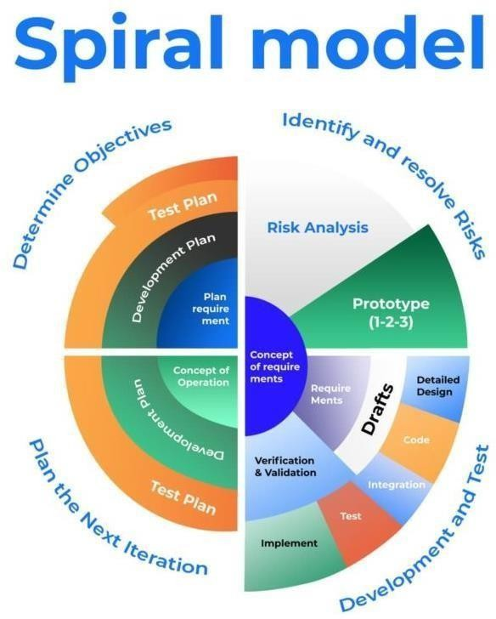
Process Model Selected (Sphiral-Model)
Fig 2.5 Spiral Model Phases

Slide 18
Hardware and Software Requirements
Software Requirements
Front-End Frameworks:
React.js for a responsive and user-friendly interface.
Material-UI or Tailwind CSS for modern and accessible UI components.
Back-End Frameworks:
Flask (Python) for handling image uploads, AI predictions, and business logic.
FastAPI (optional) for high-performance API responses.
Hardware Requirements
GPUs/TPUs for efficient deep learning model training.
Standard CPUs for running inference tasks and deployment.

Slide 19
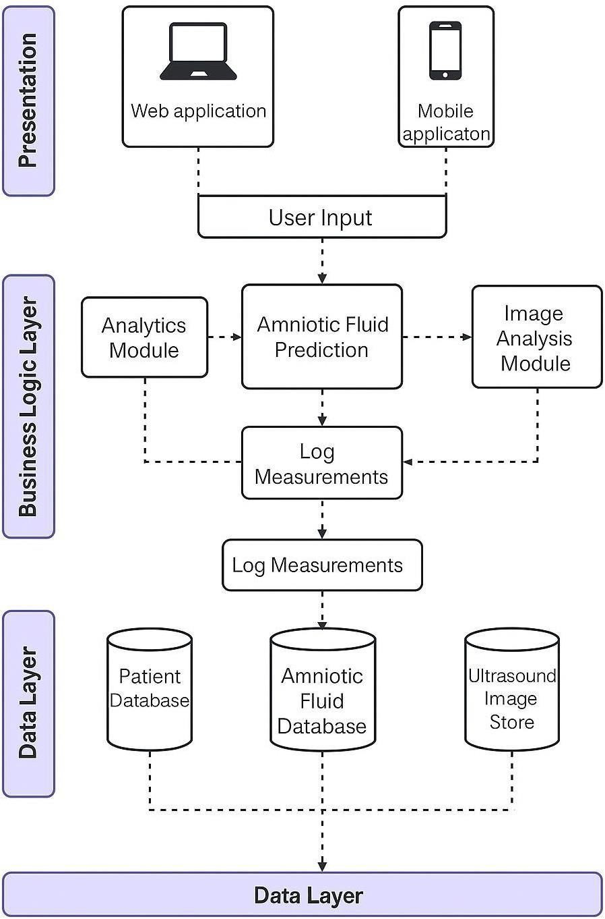
Architectural Diagram of the System

Slide 20
Review outcomes
Positive Outcomes
Improved diagnostic accuracy by automating the detection of fetal growth abnormalities and amniotic fluid levels.
Reduced dependency on manual interpretation, minimizing human errors and saving time for healthcare professionals.
Challenges
High-quality annotated medical image datasets are required for effective model training, which can be difficult to obtain.
Ensuring data privacy, security, and compliance with healthcare regulations like HIPAA is essential and complex.
Opportunities
Potential integration with telemedicine platforms for remote prenatal care and consultations.
Scope for expanding the system to detect other fetal health indicators using multi-modal imaging data.

Slide 21
Proposed Approach of the System
The proposed system uses AI-driven deep learning models like MobileNetV2 to detect fetal growth abnormalities and analyze amniotic fluid levels from X-ray and ultrasound images.
An OpenCV-based image processing pipeline ensures accurate fluid measurement by segmenting relevant regions and reducing noise.
A user-friendly web interface built with Flask and React enables real-time image uploads and analysis. The system provides predictions with confidence scores, assisting medical professionals in quick decision-making.
Overall, this approach automates fetal health assessments, improving accuracy, efficiency, and early diagnosis.

Slide 22
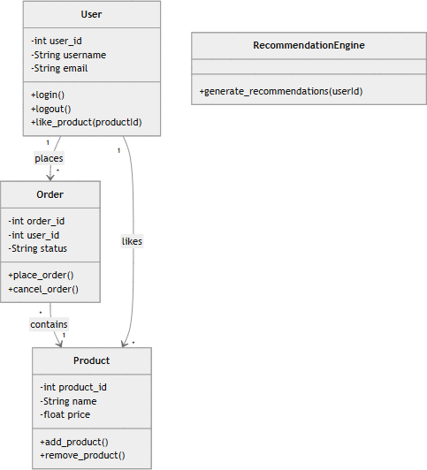
UML Diagrams
Fig : Class Diagram

Slide 23
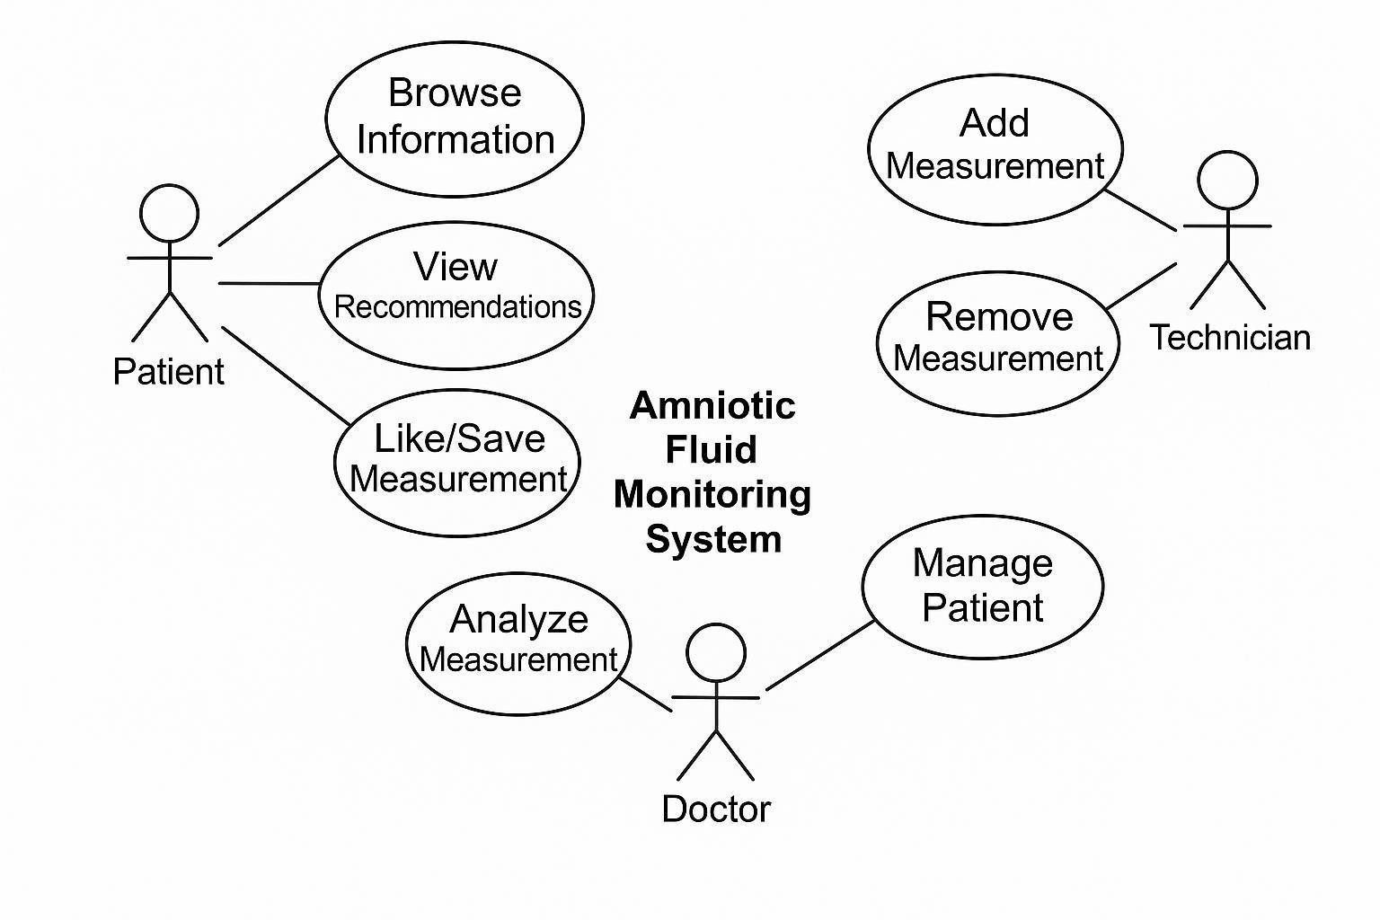
Figure : Use Case Diagram

Slide 24
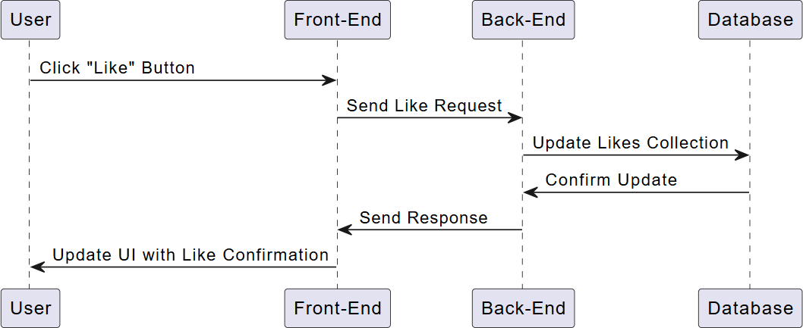
Figure :Sequence Diagram

Slide 25
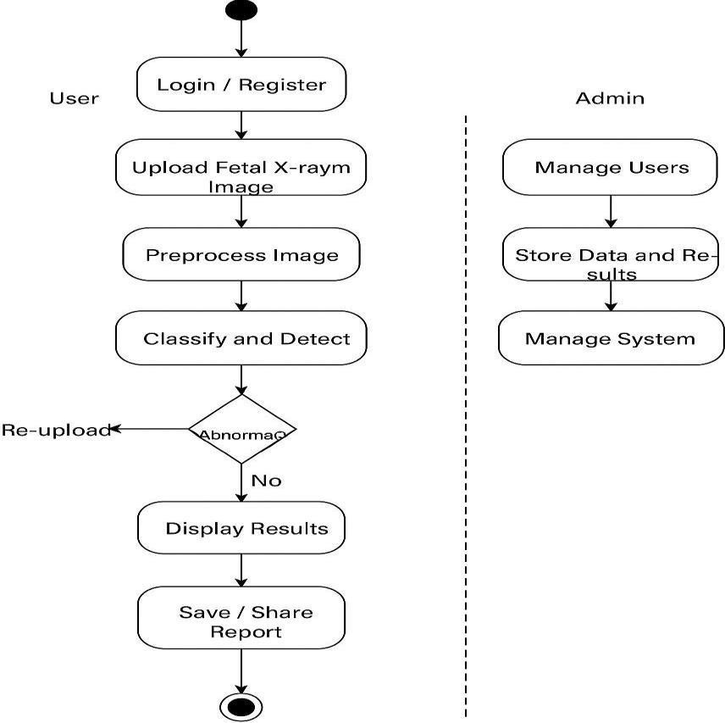
Figure : Activity Diagram

Slide 26
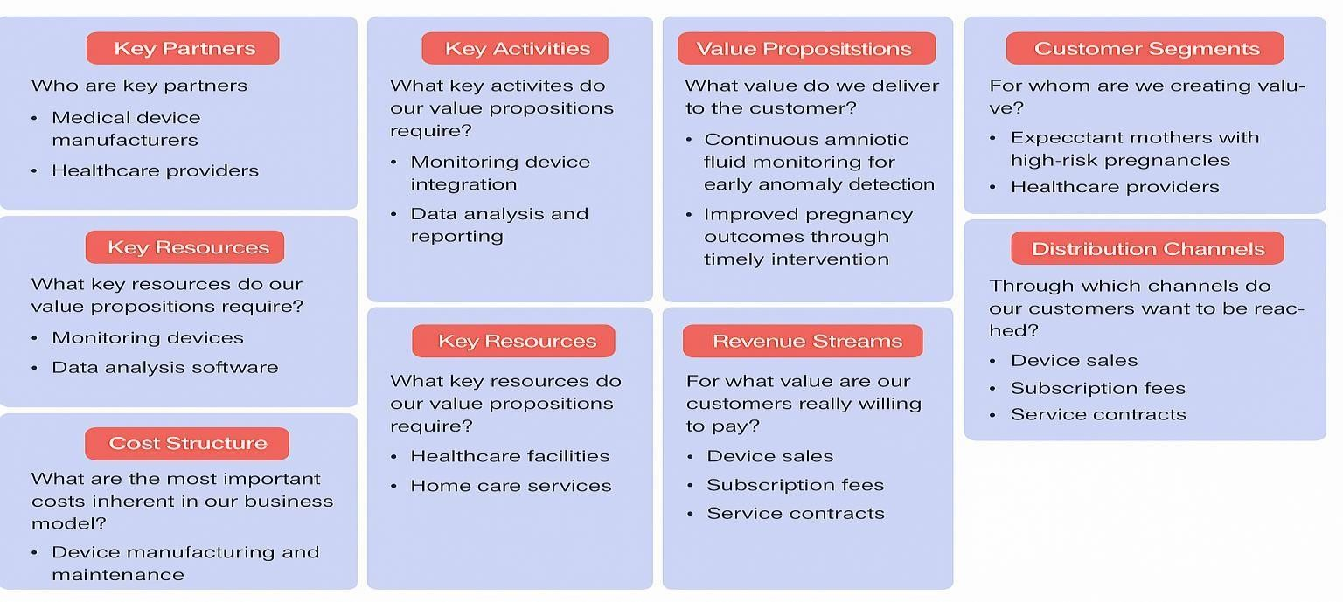
Business model canvas

Slide 27
Conclusion
Accurate and Automated Diagnosis The system leverages deep learning (MobileNetV2) and image processing techniques to automate the detection of fetal growth abnormalities and amniotic fluid levels, improving diagnostic accuracy and enabling early intervention.
User-Friendly and Secure Deployment A modern web interface ensures easy access to AI-generated insights, while robust security measures like encryption and HIPAA/GDPR compliance protect patient data, making the system reliable for clinical use.
Scalable and Future-Ready Solution The system's scalable design allows deployment in hospitals and research institutions, with potential future enhancements like 3D ultrasound integration and real-time cloud diagnostics to further improve prenatal care.

Slide 28
References
[1] Nguyen, T. D., & Tran, M. H. “Deep Learning-Based Medical Image Analysis for Fetal Health Monitoring: A Review.” Journal of Medical Imaging and Health Informatics, Volume 13, 2023, pp. 245–259. DOI: 10.1166/jmihi.2023.4001
[2] Zhang, Y., Wang, L., & Li, Z. “MobileNetV2 and Transfer Learning for Prenatal Ultrasound Image Classification.” Biomedical Signal Processing and Control,Volume 84, 2024, pp. 105–118. DOI: 10.1016/j.bspc.2024.105548
[3] Sharma, R., & Verma, P. “Application of AI in Obstetric Imaging and Fetal Anomaly Detection.” International Journal of Artificial Intelligence in Healthcare,Volume 11, 2023, pp. 322–338. DOI: 10.47505/IJAIH.2023.11.4.322
[4] Qayyum, A., & Anwar, S. “CNN Architectures for X-ray Image Classification in Healthcare: A Comparative Study.” Healthcare Informatics Research, Volume 30, 2024, pp. 89–101. DOI: 10.4258/hir.2024.30.2.89
[5] Shilpa, D. & Kumar, A. “Amniotic Fluid Index Measurement and Interpretation using AI Techniques.” International Journal of Biomedical Imaging, Volume 2023,Article ID 102347, pp. 1–12. DOI: 10.1155/2023/102347

Slide 29
[6] Sharma, A., & Mehta, R. “Medical Image Segmentation using OpenCV and Deep Learning for Fetal Applications.” Procedia Computer Science, Volume 213, 2024, pp. 745–753. DOI: 10.1016/j.procs.2024.02.087
[7] Farahani, F. V., & Samadi, R. “X-ray Analysis in Prenatal Care using Convolutional Neural Networks.” IEEE Access, Volume 12, 2024, pp. 17791–17805. DOI: 10.1109/ACCESS.2024.3301052
[8] Nandini, R., & Bhosale, M. “Fetal Anomaly Detection with Deep Learning Models using Radiological Imaging.” Journal of Obstetric Technology and Imaging, Volume 9, 2023, pp. 51–60. DOI: 10.22265/joti.2023.9.1.051
[9] Poonam, D., & Venkat, S. “Integrating AI in Maternal Healthcare: Case Study on Fetal Growth Prediction.” Artificial Intelligence in Medicine, Volume 140, 2024, Article ID 102657. DOI: 10.1016/j.artmed.2024.102657
[10] Chen, K., & Wu, J. “Automated Diagnosis from Prenatal X-ray Images Using CNN Models.” Computers in Biology and Medicine, Volume 158, 2024, Article ID 106587. DOI: 10.1016/j.compbiomed.2024.106587.

Slide 30
Thank You

